Slide 1
Graphic Design

Slide 2

Subject: Please create this flier!
Could you please create a flier to build awareness of the Graphic Designer Networking Event?
The date is Friday June 5 between 6-9 PM at the Garamond Center Bar. Admission is free. There is a surprise guest speaker!
We plan to print 200 on our in-house color printer for distribution and posting.

Slide 3
Paste the event name here
Paste the event details here

Slide 4
Graphic Designer Networking Event
Date: Friday June 5
Time: 6-9 PM
Location: Garamond Center Bar.
Admission is free.
Surprise guest speaker!

Slide 5
Project Approach
Ask yourself these questions…
To develop the project approach
Who is the audience?
What are we trying to achieve?
What mood are we targeting?
How will it be delivered to the audience?

Slide 6
Project Approach
Ask yourself these questions…
To develop the project approach
Who is the audience?
Professional graphic designers
What are we trying to achieve?
Build awareness of networking event
What mood are we targeting?
Corporate, fun, attention grabbing
How will it be delivered to the audience?
Printed in color and distributed

Slide 7
Sample Typefaces
Courier New
Times New Roman
Arial
Calibri
Trebuchet
Pacifico
Pinyon Script
Select a Typeface
Select a Typeface
Select a Typeface
Select a Typeface
Select a Typeface
Select a Typeface
Select a Typeface
Select a Typeface

Slide 8
Graphic Designer Networking Event
Date: Friday June 5
Time: 6-9 PM
Location: Garamond Center Bar.
Admission is free.
Surprise guest speaker!

Slide 9
Graphic Designer Networking Event
Date: Friday June 5
Time: 6-9 PM
Location: Garamond Center Bar.
Admission is free.
Surprise guest speaker!

Slide 10
Imagery

Slide 11
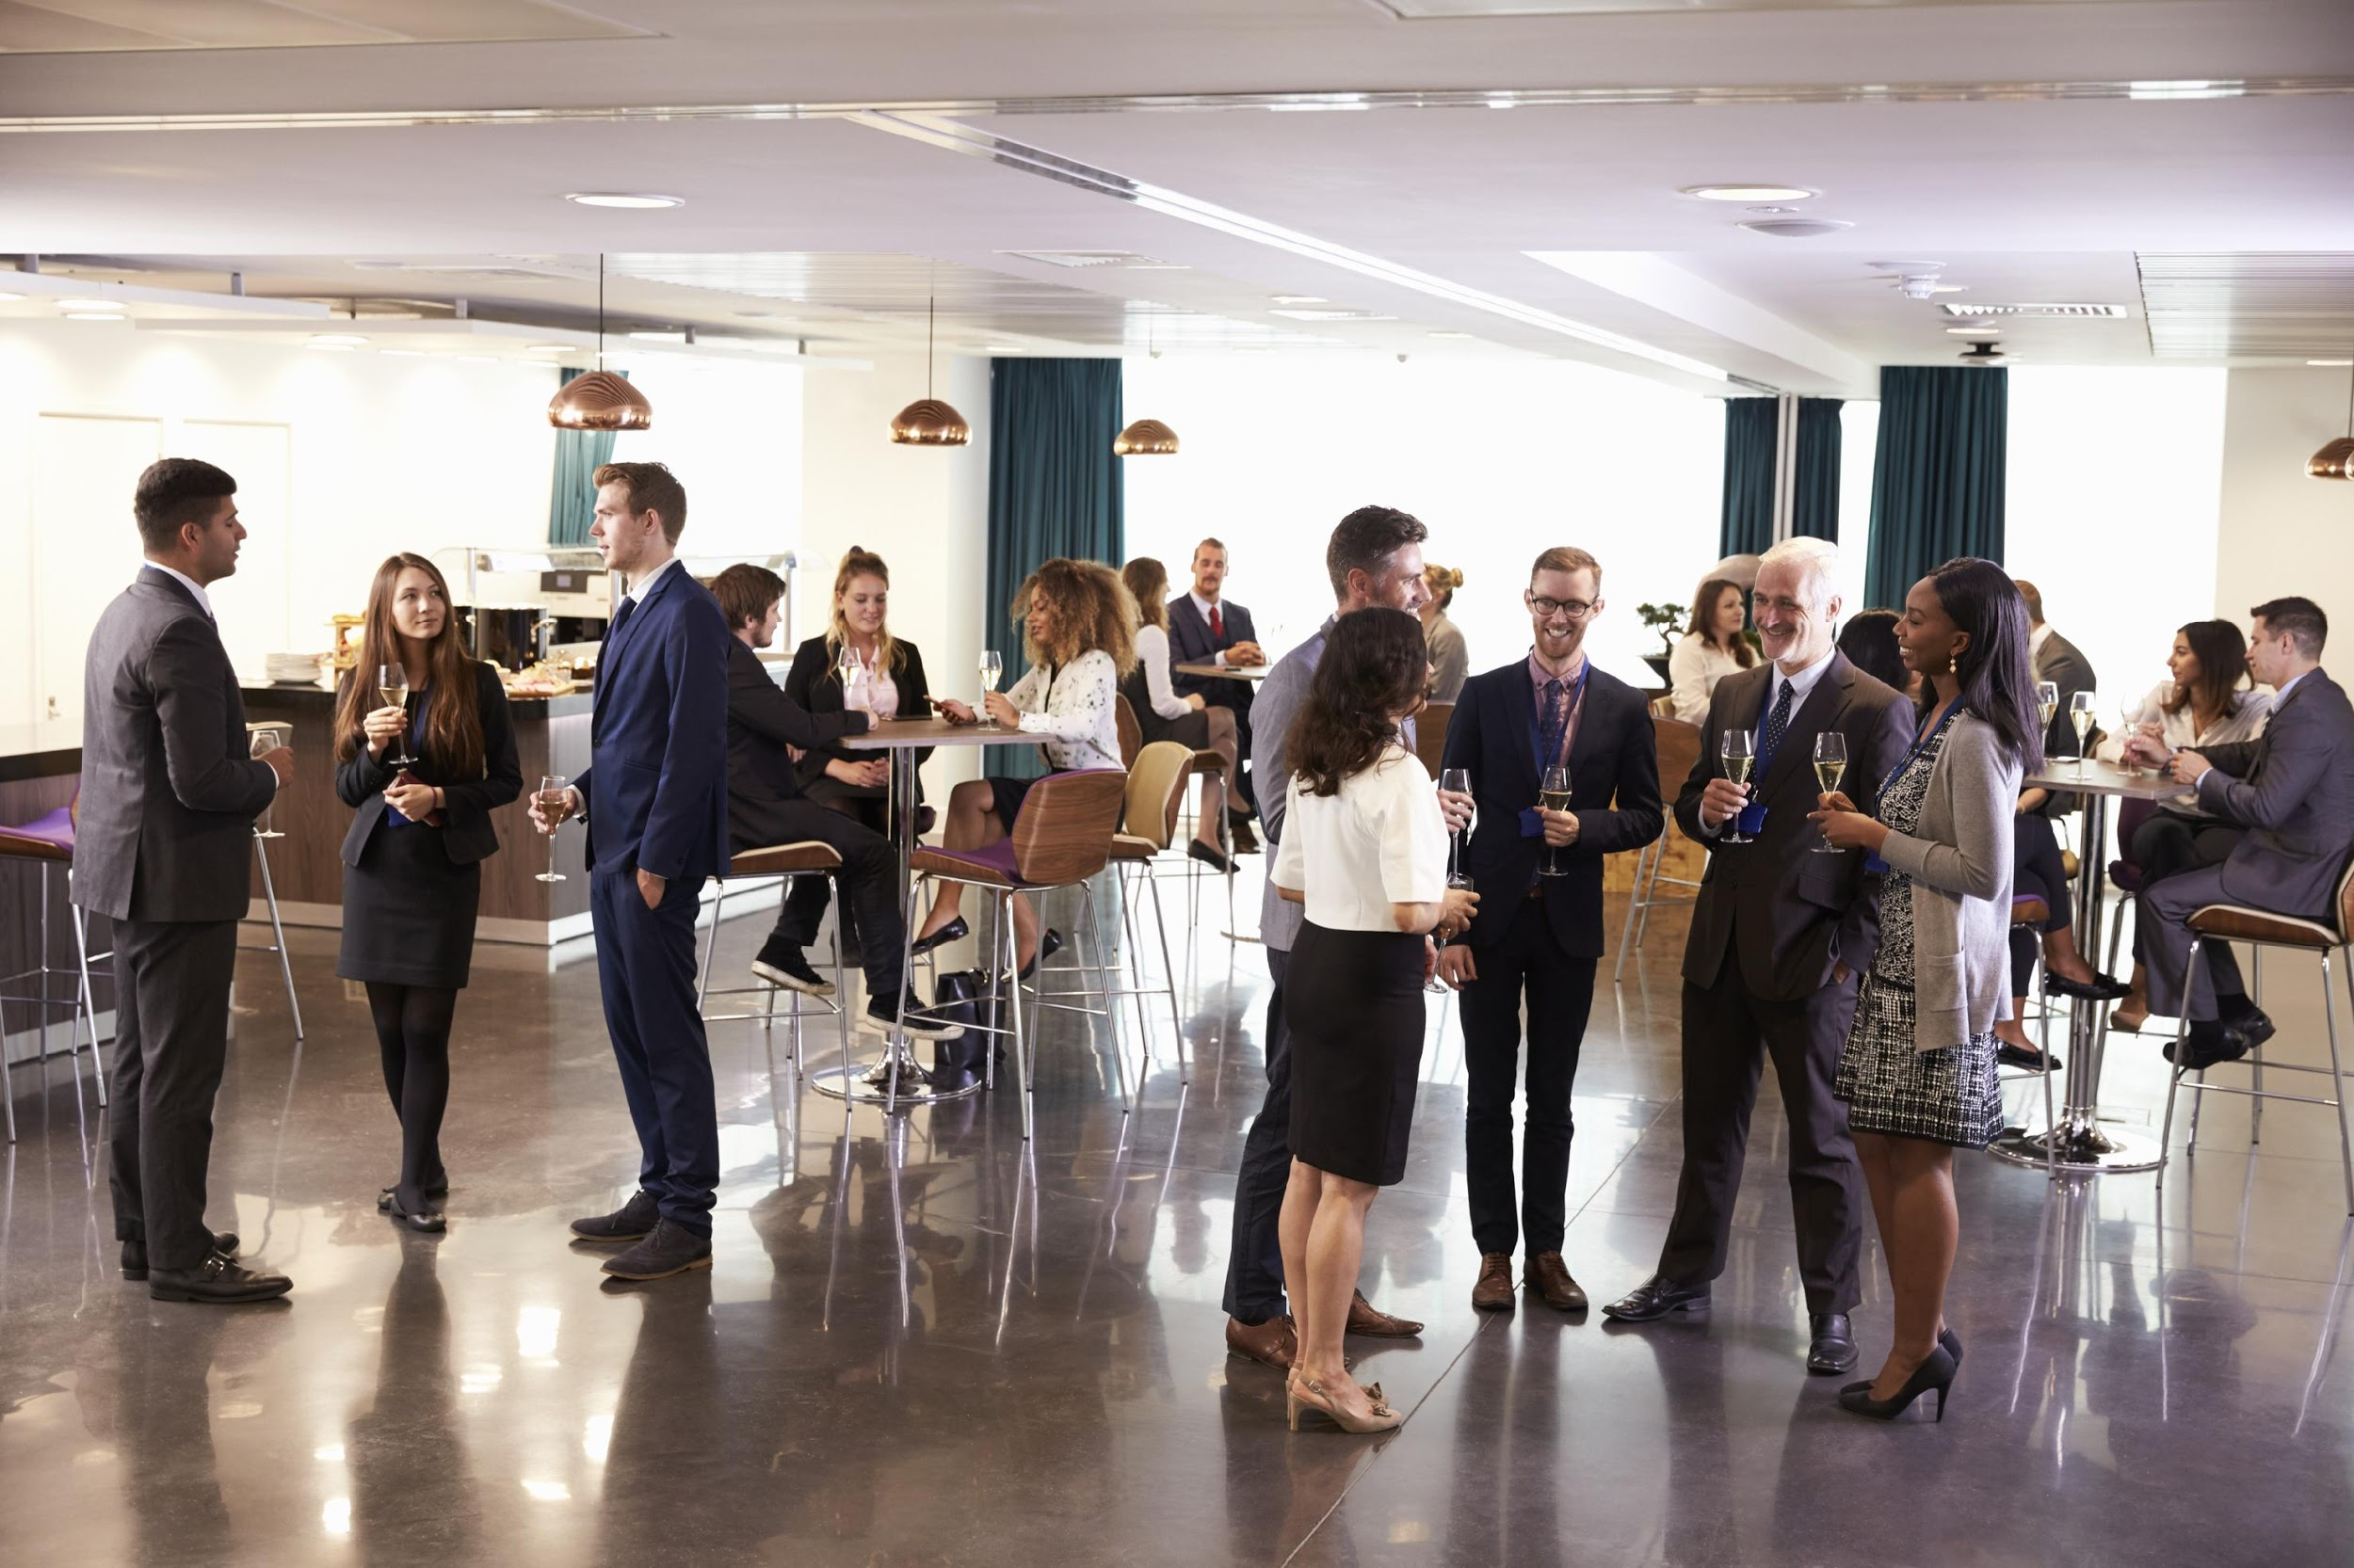


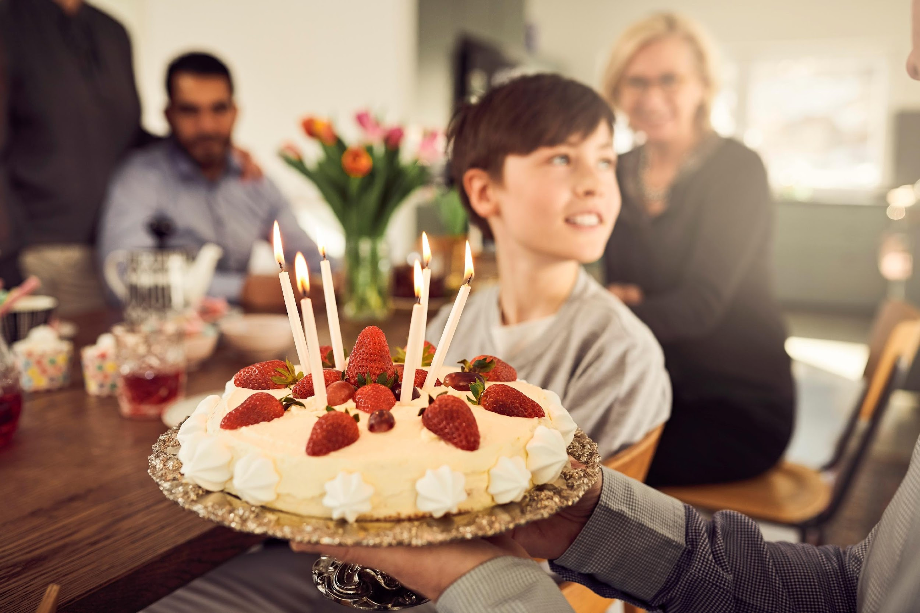

Slide 12
Graphic Designer Networking Event!
Date: Friday June 5
Time: 6-9 PM
Location: Garamond Center Bar
Admission is free. Surprise guest speaker!

Slide 13
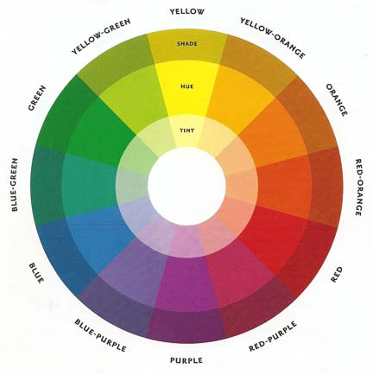
Color Wheel
Primary Colors
Opposite Palette
Secondary Colors
Thirds Palette
Neutral Colors
Adjacent Palette

Slide 14
Graphic Designer Networking Event!
Date: Friday June 5
Time: 6-9 PM
Location: Garamond Center Bar
Admission is free. Surprise guest speaker!

Slide 15
Graphic Designer Networking Event!
Date: Friday June 5
Time: 6-9 PM
Location: Garamond Center Bar
Admission is free. Surprise guest speaker!

Slide 16
Graphic Designer Networking Event!
Graphic Designer Networking Event!
Date: Friday June 5
Time: 6-9 PM
Location: Garamond Center Bar
Admission is free.
Surprise guest speaker!
Date: Friday June 5
Time: 6-9 PM
Location: Garamond Center Bar
Admission is free.
Surprise guest speaker!
Graphic Designer Networking Event!
Date: Friday June 5
Time: 6-9 PM
Location: Garamond Center Bar
Admission is free.
Surprise guest speaker!
Graphic Designer Networking Event!
Date: Friday June 5
Time: 6-9 PM
Location: Garamond Center Bar
Admission is free.
Surprise guest speaker!

Slide 17
Graphic Designer Networking Event!
Date: Friday June 5
Time: 6-9 PM
Location: Garamond Center Bar
Admission is free.
Surprise guest speaker!

Slide 18
Graphic Designer Networking Event!
Date: Friday June 5
Time: 6-9 PM
Location: Garamond Center Bar
Admission is free.
Surprise guest speaker!

Slide 19
Graphic Designer Networking Event!
Date: Friday June 5
Time: 6-9 PM
Location: Garamond Center Bar
Admission is free.
Surprise guest speaker!

